Slide 1


Slide 2

Marginal Revenue
Profit maximization and loss minimization
The short-run supply curve
The long-run supply curve
The shut-down and break-even points
Economic efficiency

Slide 3
Total Revenue is price X output
Marginal revenue is the increase in total revenue when output sold goes up by one unit
Output Price Total Revenue Marginal Revenue
1 $5 $ 5 $5
2 5 10 5
3 5 15 5
4 5 20 5
5 5 25 5
6 5 30 5

Slide 4

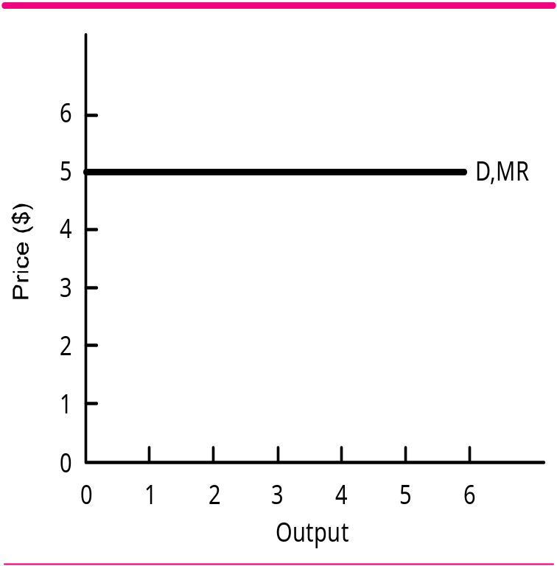
Output Price Total Revenue Marginal Revenue
1 $5 $ 5 $5
2 5 10 5
3 5 15 5
4 5 20 5
5 5 25 5
6 5 30 5

Slide 5
Profit Maximization and Loss Minimization
Output Price TR MR TC ATC MC Total Profits 1 1 $200 $200 $200 $500 $500 $100 - $300 1 2 200 400 200 550 275 50 - 150 1 3 200 600 200 610 203 60 - 10 1 4 200 800 200 700 175 90 100 1 5 200 1000 200 830 166 130 170 1 6 200 1200 200 1000 167 170 200 1 7 200 1400 200 1205 172 205 195
Profit Maximization Point: MC = MR

Slide 6
Profit Maximization and Loss Minimization
Output Price TR MR TC ATC MC Total Profits 1 $200 $200 $200 $500 $500 $100 - $300
2 200 400 200 550 275 50 - 150
3 200 600 200 610 203 60 - 10
4 200 800 200 700 175 90 100 5 200 1000 200 830 166 130 170 6 200 1200 200 1000 167 170 200 7 200 1400 200 1205 172 205 195
Profit Maximization Point: MC = MR
This occurs somewhere between 6 and 7 units.
We are assuming output can be produced in tenths of a unit

Slide 7
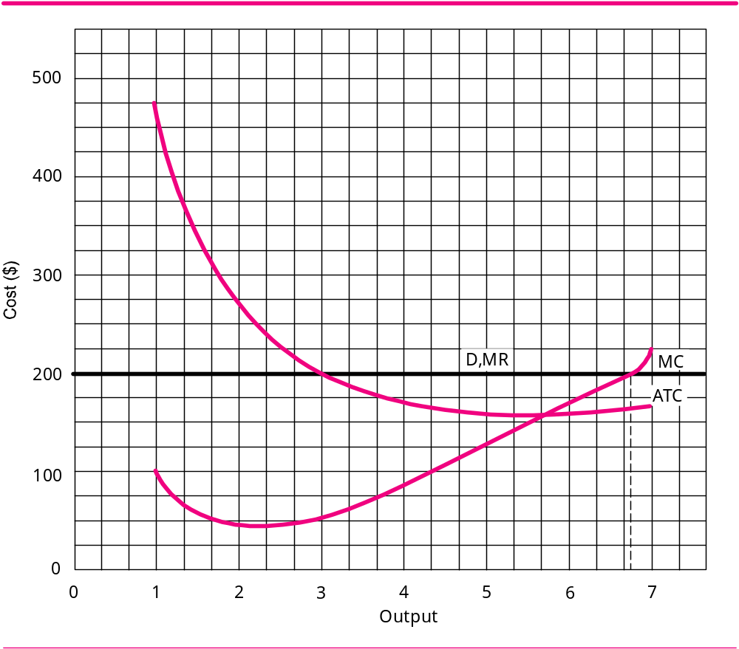
Profit Maximization and Loss Minimization
Output MR MC 1 $200 $100 2 200 50 3 200 60 4 200 90 5 200 130 6 200 170 7 200 205
Profit Maximization Point: MC = MR
The most profitable output is where the MC curve crosses the D, MR curve. This occurs at an output of 6.7 units

Slide 8
Profit Maximization and Loss Minimization
Total Profit=(Price-ATC) X Output
TP=Total Profit; P=Price
TP=(P-ATC) X Output
TP=$200-$170) X 6.7
TP=$30 X 6.7
TP=$201
Price is $200
ATC is $170
Profit Maximization Point: MC = MR
The most profitable output is where the MC curve crosses the D, MR curve. This occurs at an output of 6.7 units

Slide 9
Making Sure We Are Maximizing Profit
Output Profit
6.0. . . . . . . . . . . . . $200
6.1
6.2
6.3
6.4
6.5
6.6
6.7 . . . . . . . . . . . . . . 201 <------ Best that we can do!
6.8
6.9
7.0 . . . . . . . . . . . . . . 195
If you calculated the total profit at every level of output (6.1 through 6.9) you would find that the output level of 6.7 units would provide you with the greatest level of profit.
This is the output level where MC=MR

Slide 10
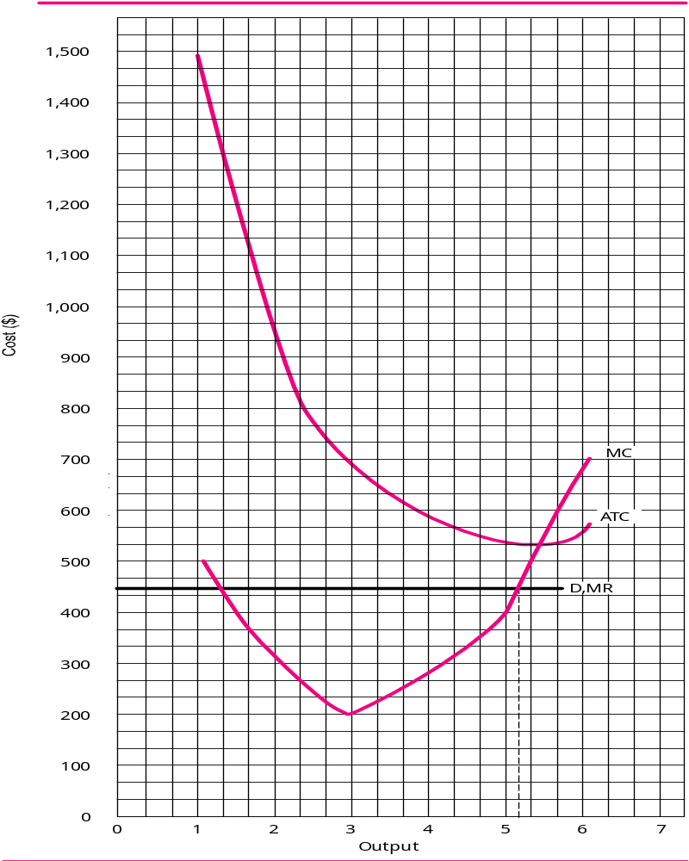
Profit Maximization and Loss Minimization
TP = (P-ATC) X Output
TP = $450-$533) X 5.2
TP = -$83 X 5.2
TP = -$431.60
In this particular instance, losses were minimized
Profit Maximization Point: MC = MR
ATC is $533
Price is $450
The most profitable output is where the MC curve crosses the D, MR curve. This occurs at an output of about 5.2 units
21-10
Copyright ©2002 by The McGraw-Hill Companies, Inc. All rights reserved.

Slide 11
Making Sure We Are Minimizing Losses
Output Profit
5.0 - $450.00
5.1
5.2 - 431.60 <----Best we can do!
5.3
5.4
5.5
5.6
5.7
5.8
5.9
6.0 - 700.00
If you calculated the total profit at every level of output (5.1 through 5.9) you would find that the output level of 5.2 units would provide you with the smallest possible loss.
This is the output level where MC=MR

Slide 12

MR is the additional revenue from selling one more unit of output
MC is the additional cost of producing one more unit of output
We keep adding to output as long as MR exceeds MC
  If we stop short of this point, we would not maximize our profit
We stop adding to output when MR = MC
  If we continued to add output MC would exceed MR and this would diminish our profits

Slide 13

The Short-Run Supply Curve
A firm will always produce where MC equals MR
A firm will operate in the short-run if sales (TR) are greater than variable cost (VC) [ Remember TR = Price X Output]
A firm will shut down if variable cost (VC) are greater than sales (TR) [Remember, sales and TR are the same]
Therefore, a firm will shut down if VC is greater TR or if VC are greater than Price X Output

Slide 14
A firm will shut down if VC > TR or if VC > Price X Output
A firm will shut down if
VC > Price X Output
Let’s divide both side of the above equation by Output
VC > Price X Output
Output
Output

Slide 15
A firm will shut down if VC > TR or if VC > Price X Output
A firm will shut down if
VC > Price X Output
Let’s divide both side of the above equation by Output
VC > Price X Output
Output
Output
AVC
>
Price

Slide 16
A firm will shut down if VC > TR or if VC > Price X Output
A firm will shut down if
VC > Price X Output
Let’s divide both sides of the above equation by Output
VC > Price X Output
Output
Output
AVC
>
Price

Slide 17
In the short-run a firm will shut down if the AVC is greater than the price
Alternatively
In the short-run a firm will operate if the price is greater than the AVC

Slide 18

At any given time, a business firm will have a certain set of cost curves: AVC, ATC, and MC.
  These curves are determined mainly by the firm’s capital stock – its plant and equipment
Over time these curves can change, but at any given time they’re fixed
At any given time, we can assume the MC curve doesn’t change

Slide 19

MC must equal MR
MC stays the same
MR can change to any value because whenever price changes we have an new MR line
When the price changes MR changes and will equal MC at some other point on the MC curve

Slide 20
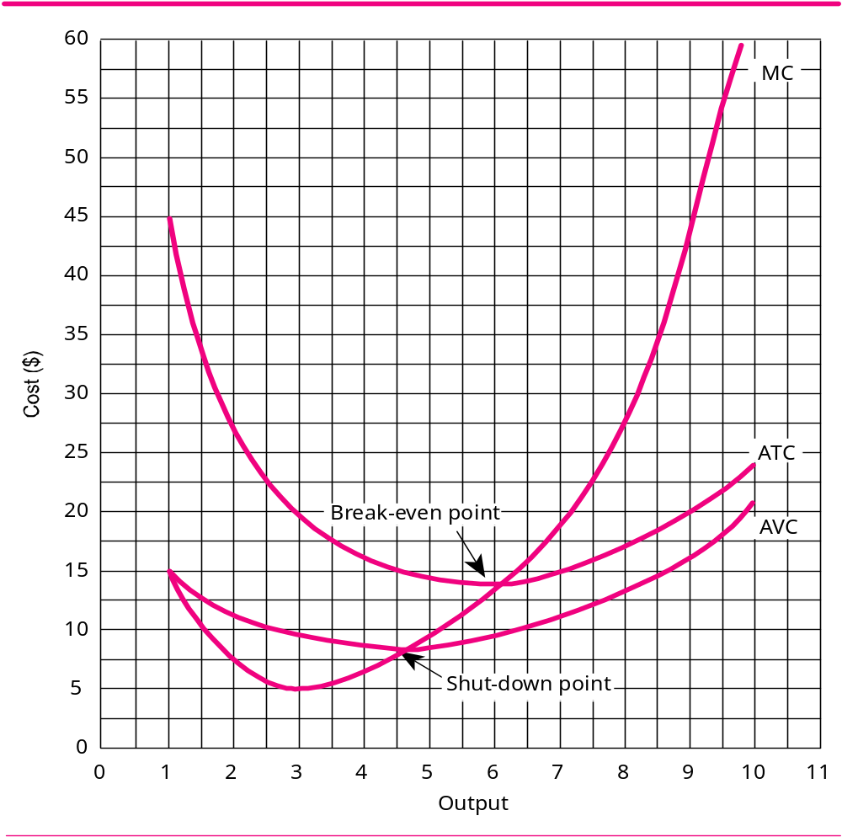
Derivation of a Firm’s Short-Run & Long-Run Supply Curve
The firm’s short-run supply curve begins at the shut-down point and runs all the way up the MC curve
The firm’s long-run supply curve begins at the break-even point and runs all the way up the MC curve
Minimum point on the ATC
Minimum point on the AVC

Slide 21

In the short run
  If the price is below the shut-down point, the firm will shut down
  If the price is above the shut-down point, the firm will operate
In the long run
  If the price is below the break-even point, the firm will go out of business
  If the price is above the break-even point, the firm will stay in business

Slide 22
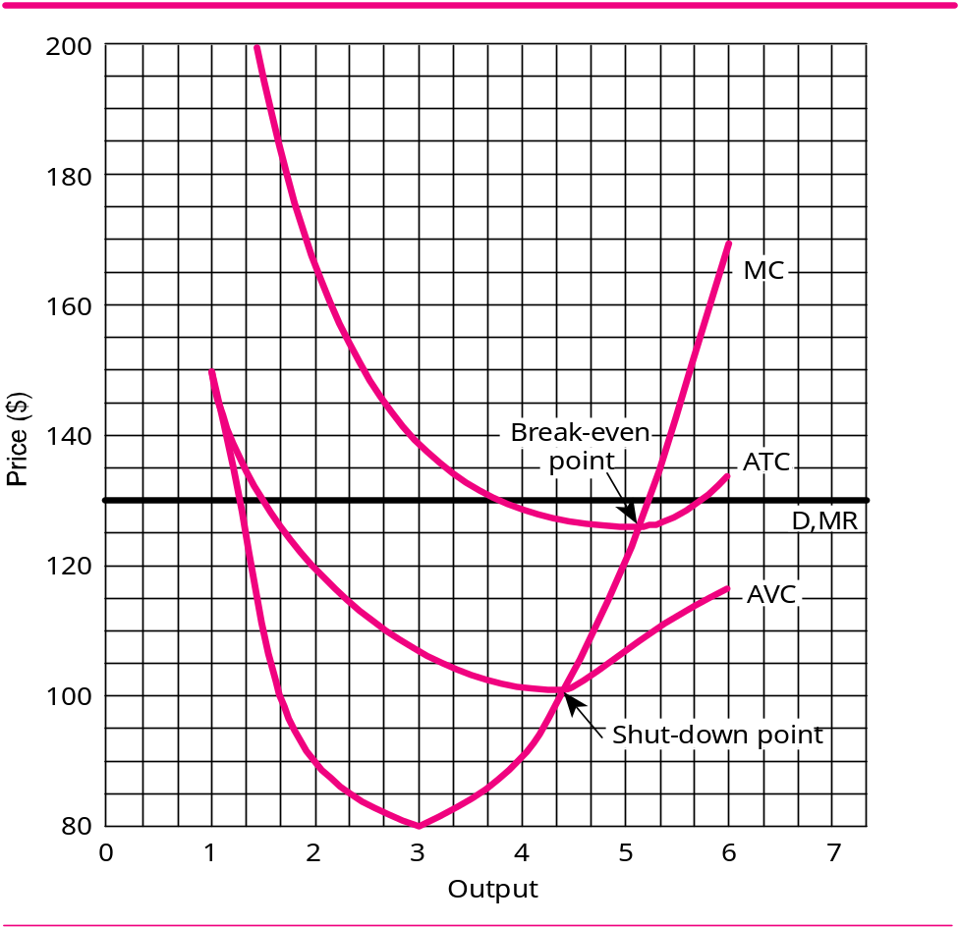
The Shut-Down and Break-Even Points
What is the lowest price the firm will accept in the short run?
Answer: $101
Output AVC ATC Total Profits 1 $150 $250 -$120 2 120 170 - 80 3 106.67 140 - 30 4 102.50 127.50 + 10 5 106 126 + 20 6 116.67 133.33 - 20

Slide 23
The Shut-Down and Break-Even Points
What is the lowest price the firm will accept in the long run?
Answer: $125.50
Output AVC ATC Total Profits 1 $150 $250 -$120 2 120 170 - 80 3 106.67 140 - 30 4 102.50 127.50 + 10 5 106 126 + 20 6 116.67 133.33 - 20

Slide 24
The Shut-Down and Break-Even Points
Calculate Total Profit
TP = (P – ATC) X Output
TP = ($130 – $126) X 5.25
TP = 4 X 5.25
TP = $21
Price is 130
ATC is 126
Output is 5.25

Slide 25
The Shut-Down and Break-Even Points
How much will the firm’s output be in the short run and the long run if the price is $170?
D, MR
The firm will maximize profits at an output of 6
In both the short run and the long run the output will be six because that is where MC = MR

Slide 26
The Shut-Down and Break-Even Points
How much will the firm’s output be in the short run and the long run if the price is $115?
The firm will maximize profits at an output of 4.85
The output in the shot run will be 4.85 because the price is above the shut-down point. The output in the long run will be zero because the price is below the break-even point.
D, MR

Slide 27
The Shut-Down and Break-Even Points
How much will the firm’s output be in the short run and the long-run if the price is $90?
The answer to both questions is zero. The price of $90 is below both the break-even point and the shut-down point.
D, MR
In the short run the firm will shut down. In the long run the firm will go out of business

Slide 28
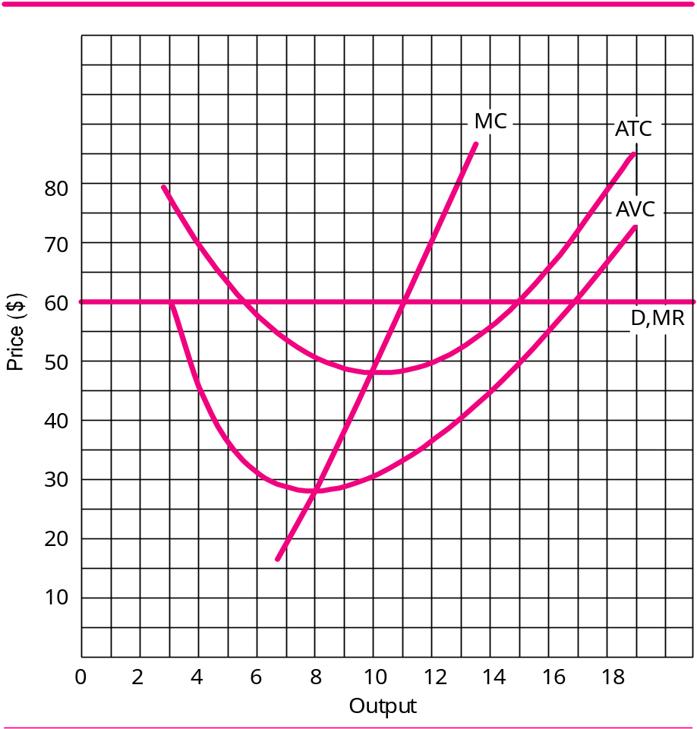
The Most Efficient Output
How much is the firm’s most efficient output?
This occurs at an output of 10, which is the minimum point on the ATC (which is the break-even point)
How much is the most profitable output?
This occurs at an output of 11 which is where MC=MR

Slide 29


